Slide 1
TraceRoute
Sean Aryana, Andrew Gammon, Keith yang
cse481L – Spring 2015

Slide 2
Motivation
Interior navigation. Orient yourself without using GPS! (Pedestrian dead reckoning)
Saves power, and can give you movement data in 3D space
Phones have lots of cool sensors to play with
It’s a field of active research and experimentation!
Has many possible use cases (i.e. museums, aquarium)

Slide 3
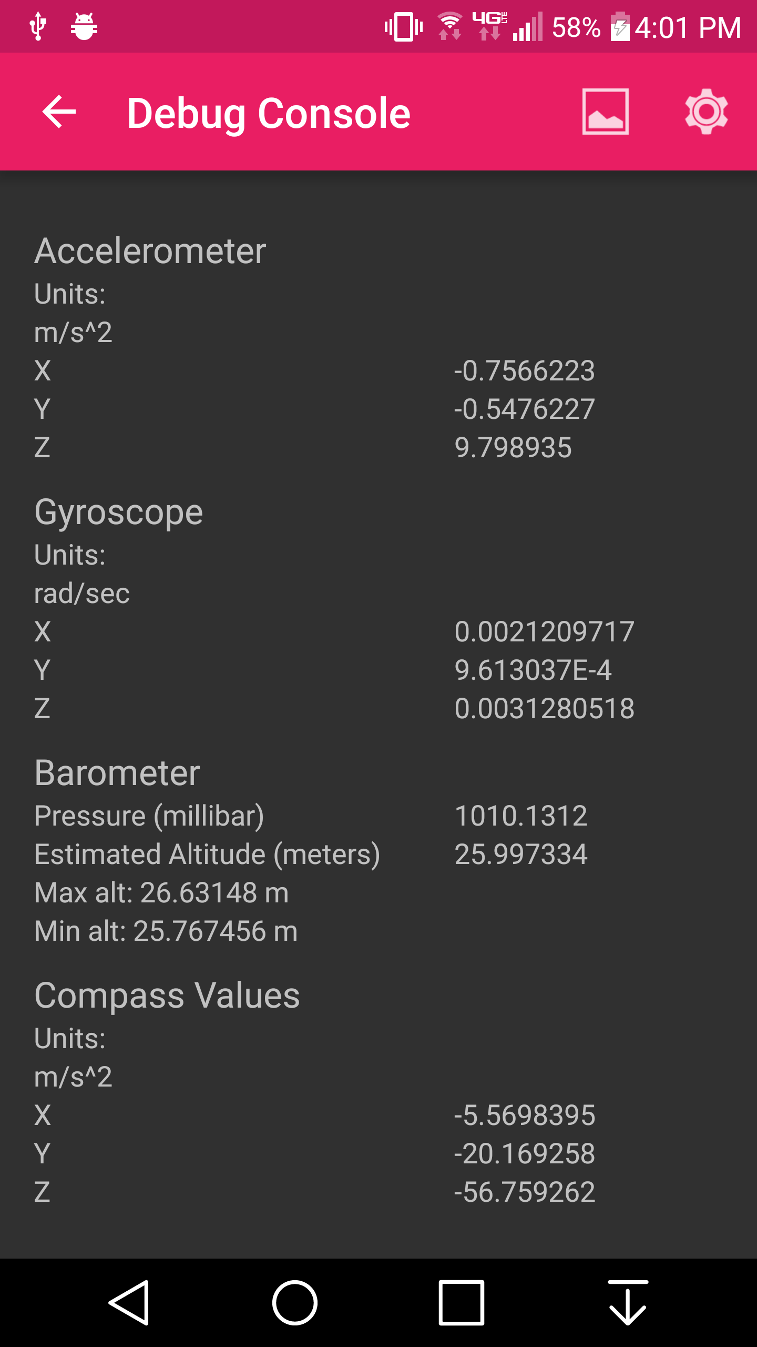
What we Learned - Sensors
Accelerometer produces incredibly noisy data
Gyroscope tends to drift as time goes on
Compass needs to be oriented on a flat surface
Barometer measurements bounce around
Step detector can be delayed

Slide 4
What we Learned - Navigation
Distance
Double integrating acceleration would produce too much error
Stride length from height and gender of the user decent indicator
Direction
Accelerometer too sporadic for accurate direction
Gyroscope doesn’t indicate which way user is moving
Compass does a decent job
Altitude
Barometer will level out over time

Slide 5
So how did we get things to work?
Sensor Fusion!
Detect drift and then set up new standard
Use multiple sources for direction
Low pass filters makes the sensors data less noisy

Slide 6
What we Learned - OpenGL
Lots of math!
Clumsy API – OpenGL ES
Things that are intuitive from a user perspective (camera control, lighting) are fairly involved processes

Slide 7
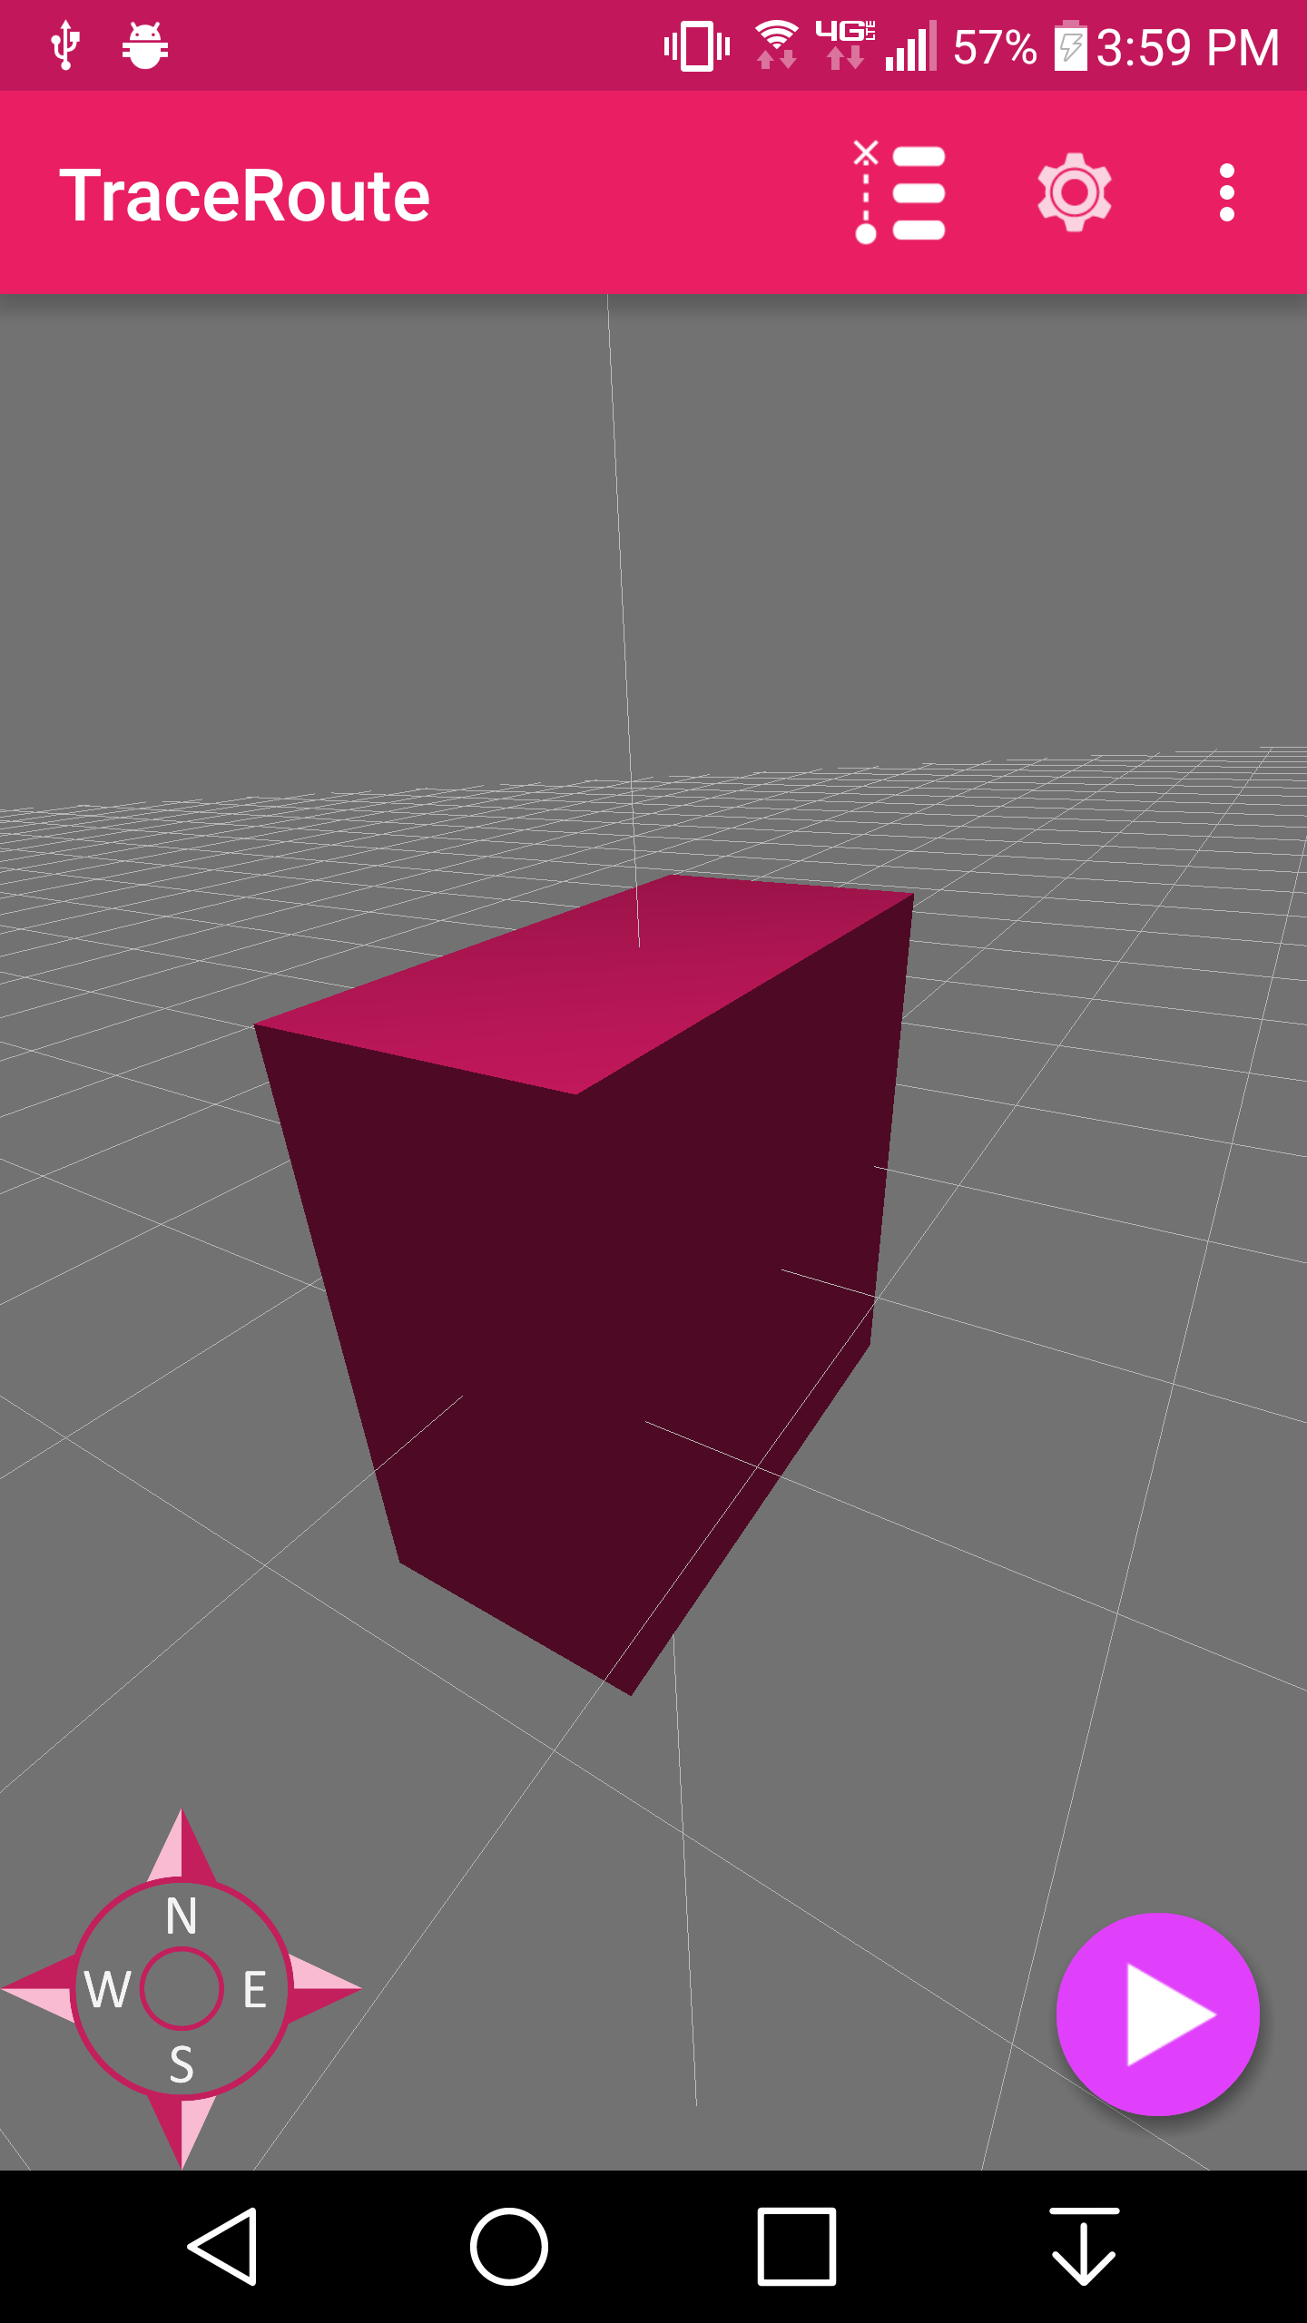
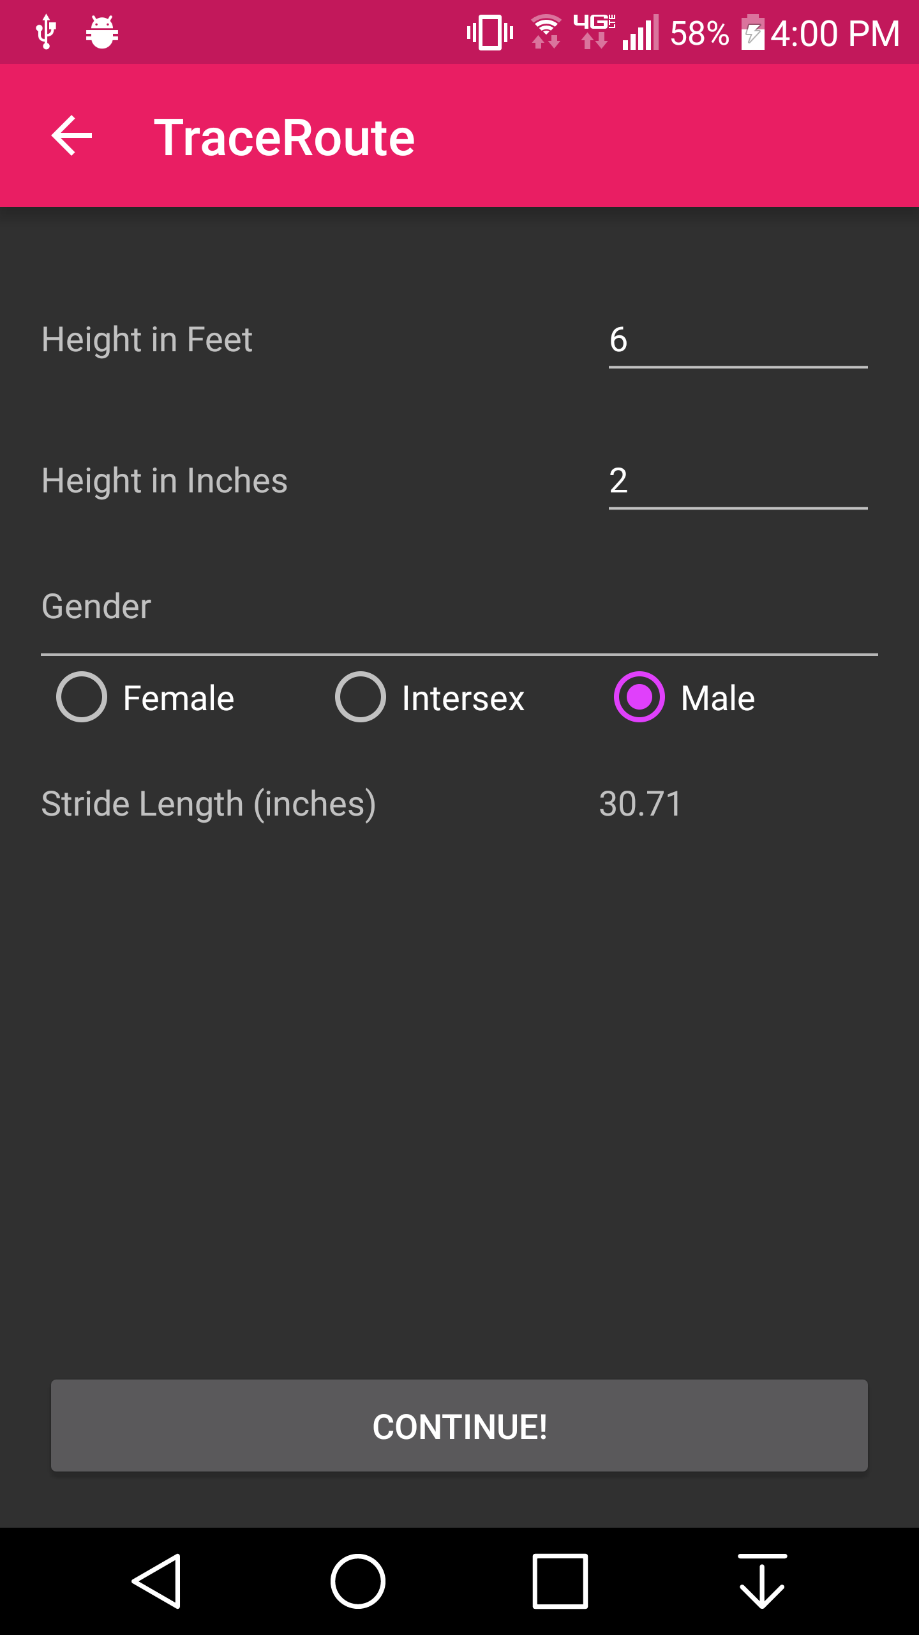
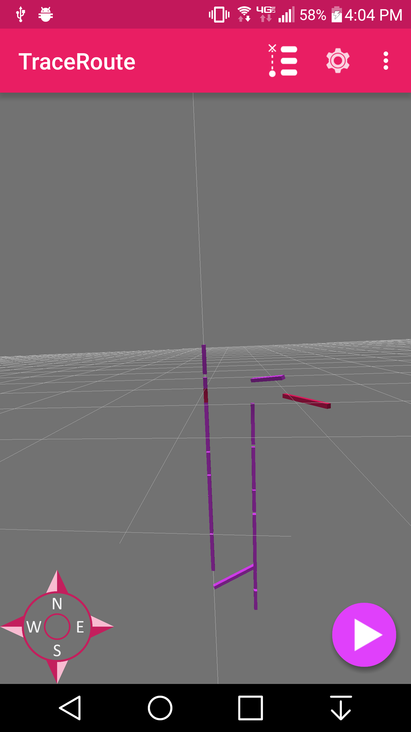
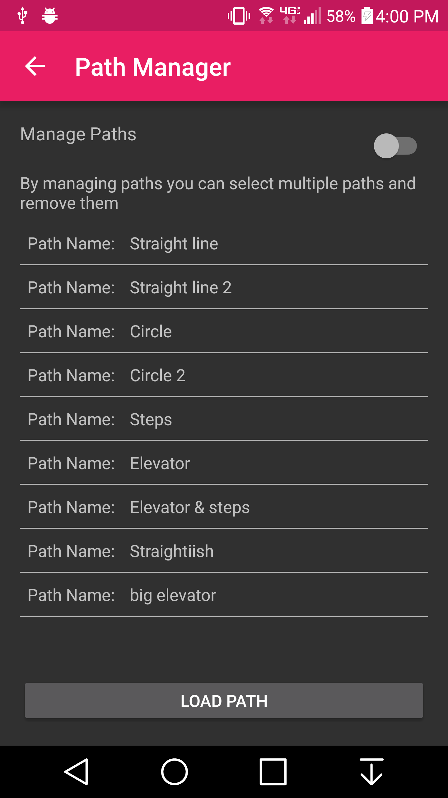
What we Built
Main Screen
User Settings
VR Mode
Path Manager

Slide 8
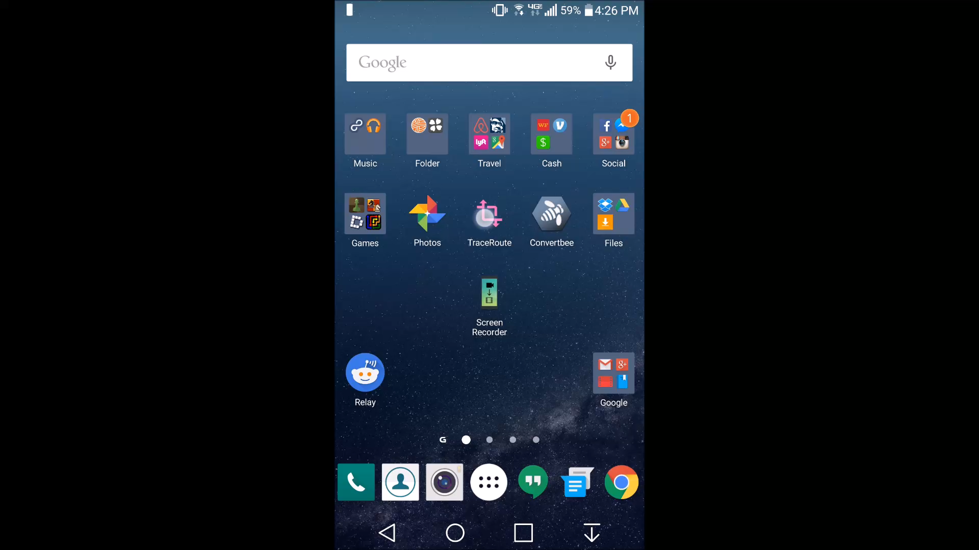

Slide 9
Where to go from here?
Bluetooth beacons or other access points
Better direction detection
Accurate positioning
Push cards to phone based off of position
Kalman filter for path prediction

